Slide 1


Traffic Density Analysis Using Image Processing
PRESENTED BY:
Kashindra Mahato(Roll-171549)
Rajan Paudel(Roll-171550)
Supervisor：Dr Roshan Chitrakar
Department of Information Technology
Nepal College of Information Technology

Slide 2
CONTENT
Introduction
Importance of the Project
Challenges
Features
Algorithm
System Requirements

Slide 3
Final Result
Future plans
Conclusion

Slide 4
Introduction
This system is a computer vision-based vehicle counting system.

Slide 5

To optimize the traffic signal system
Number plate recognition
Importance of the project
Real time vehicle counting
To detect traffic rule violation
To monitor and estimate traffic flow
To redirect the traffic to alternate roads

Slide 6
In this method, it is difficult to obtain a complete outline of moving object.
Challenges
Accuracy is less because Reference image is changing in each and every iteration so we do not get exact amount of traffic volume.
24-hours electricity supply to the camera, Climatic change , fog, smog.
Greater velocity of vehicle and intense sunlight.
Can detect only in daylight.

Slide 7
Features of the Project
Store the count in the Database
Detects the vehicle
Count the Vehicle

Slide 8
Algorithm
Generating a foreground mask (namely, a binary image containing the pixels belonging to moving objects in the scene) by using static cameras.
Erosion and Dilation:
Remove noise
Isolate individual elements and join disparate elements in an image
Find intensity bumbs or holes in an image.
This image analysis technique is a type of image segmentation that isolates objects by converting grayscale image into binary images.
Contours can be explained simply as a curve joining all the continuous points, having same color or intensity
A blob is a group of connected pixels in an image that share some common property
Background
Subtraction
Image
Thresholding
Morphological
Operation
Contours
Blob
Detection

Slide 9
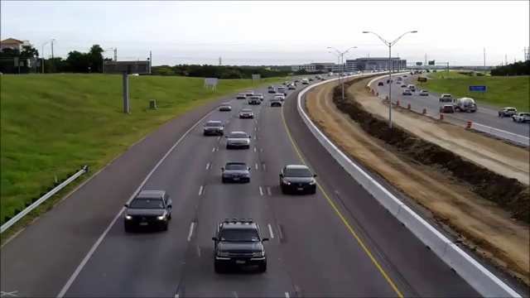
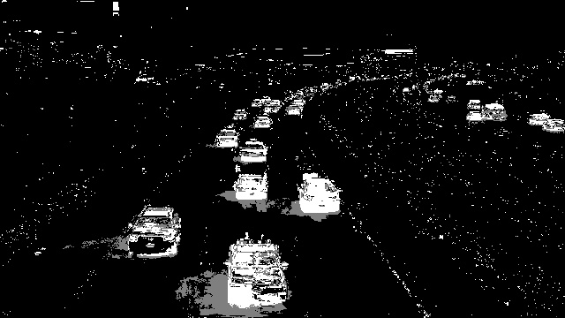
Original Frame
Frame after Background Subtraction

Slide 10
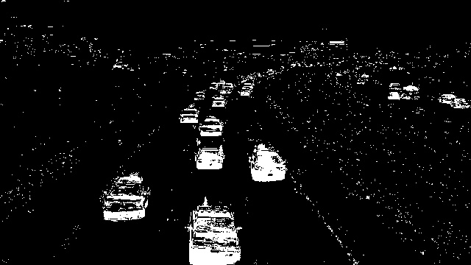

Result of Image Thresholding
Result of Morphological operations

Slide 11
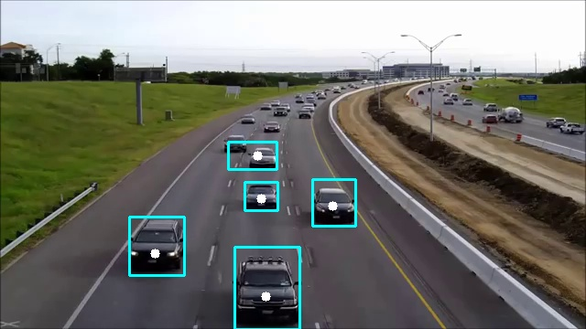
Result of contour Detection and blob Analysis.

Slide 12




System Requirements
Operating System
Windows 10
Linux
Library
IDE
OpenCV
Numpy
Pycharm
Spyder
Database
MySQL

Slide 13
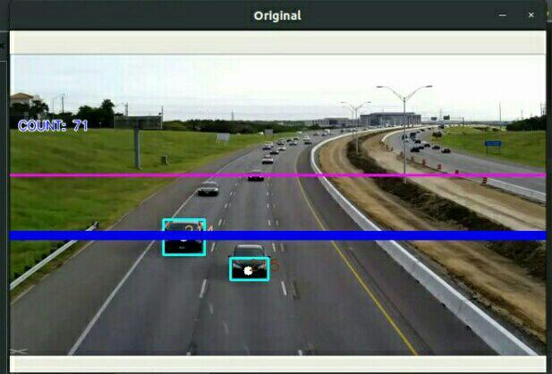
Final Result
Reference lines are drawn and once the object pass the assigned reference line count is increased

Slide 14
Future works
Adding more real life features.
Making this system more robust.
Adding number plate Detection.
Adding Traffic violation conditions.
Vehicles classification.

Slide 15
Conclusion
A framework for vehicle detection and counting is developed.
Efficiency of this model as observed is higher compared to other traditional methods.
Limitations were found such as: counting vehicles during low light conditions, missing to count the fast moving vehicles etc..

Slide 16
THANKS

